Slide 1
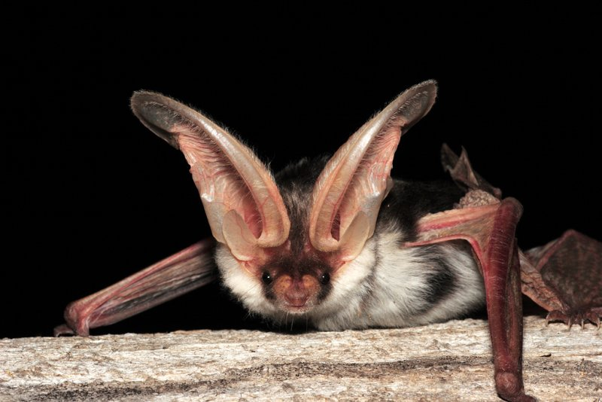
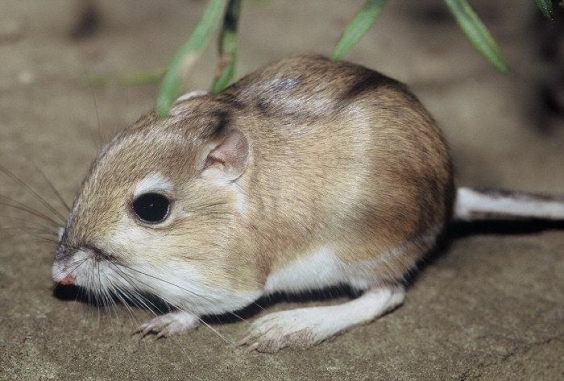
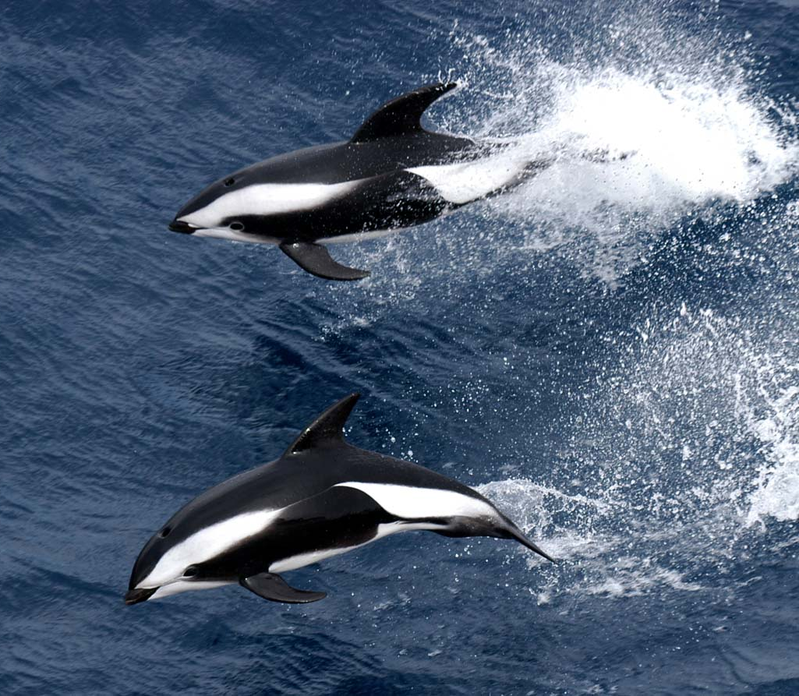
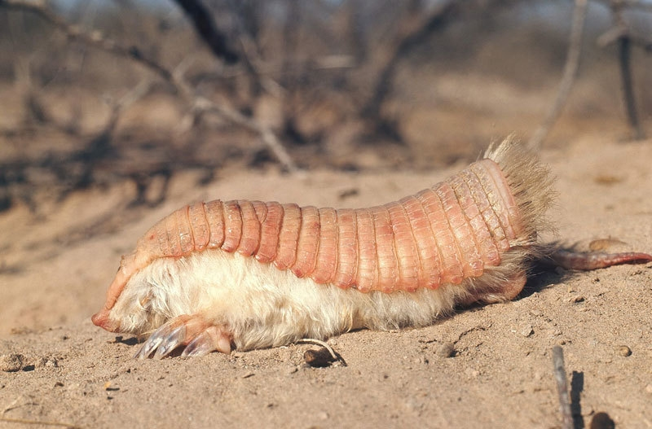
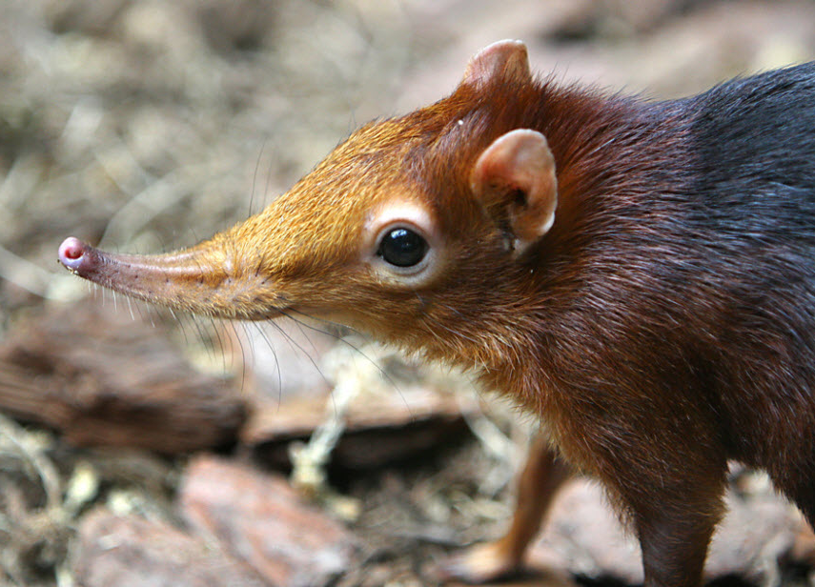
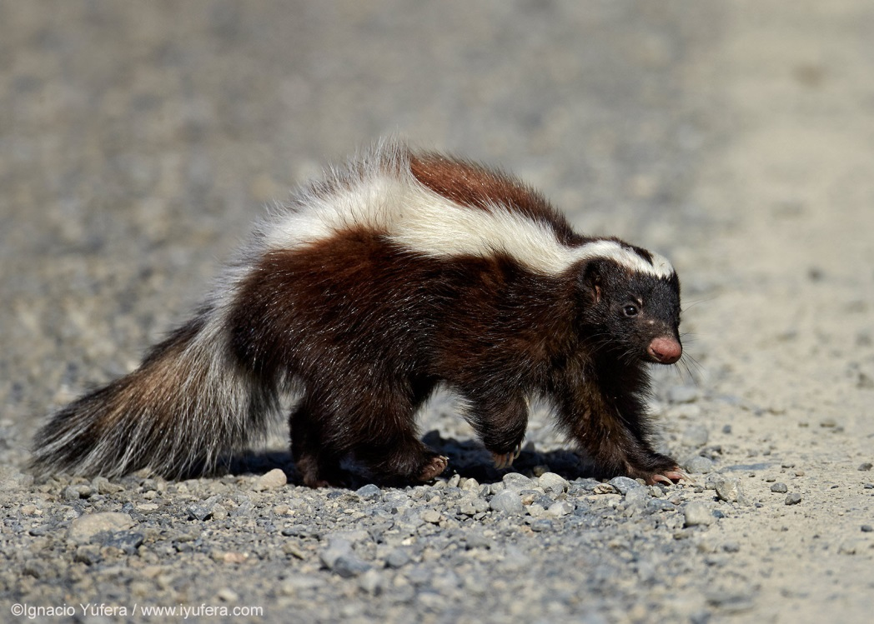
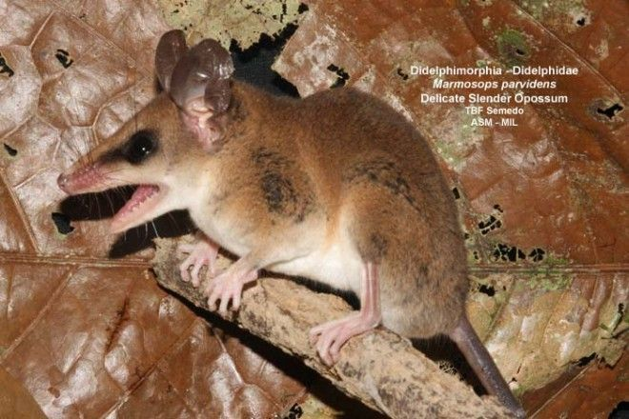
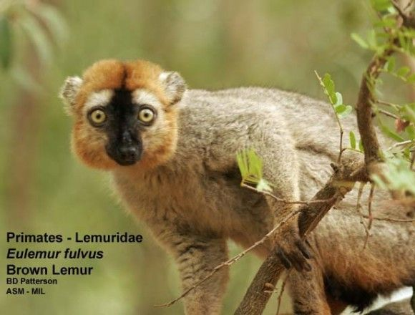
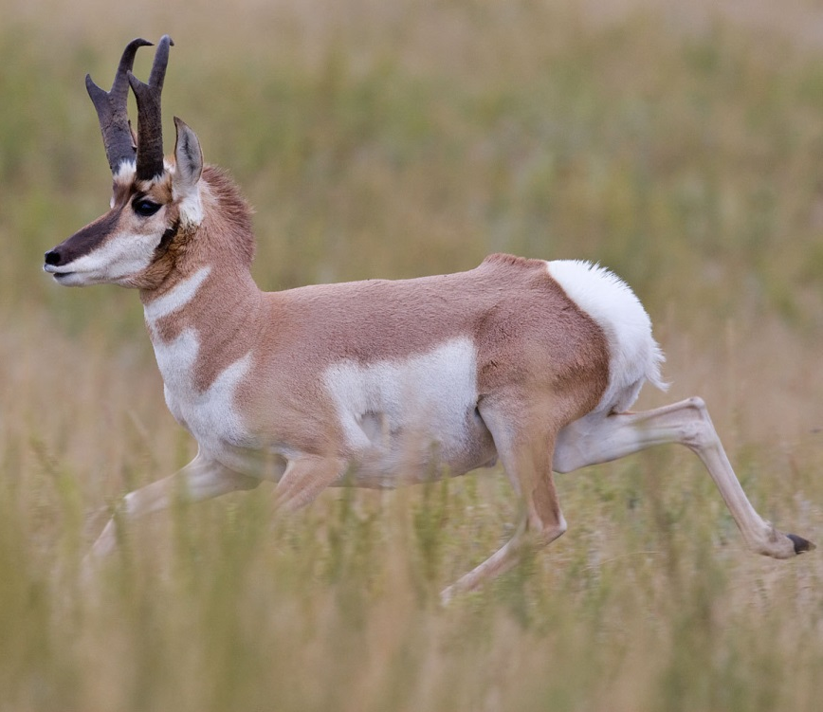
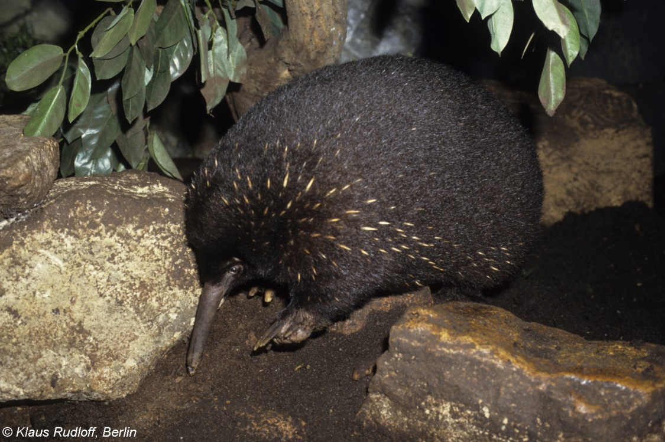
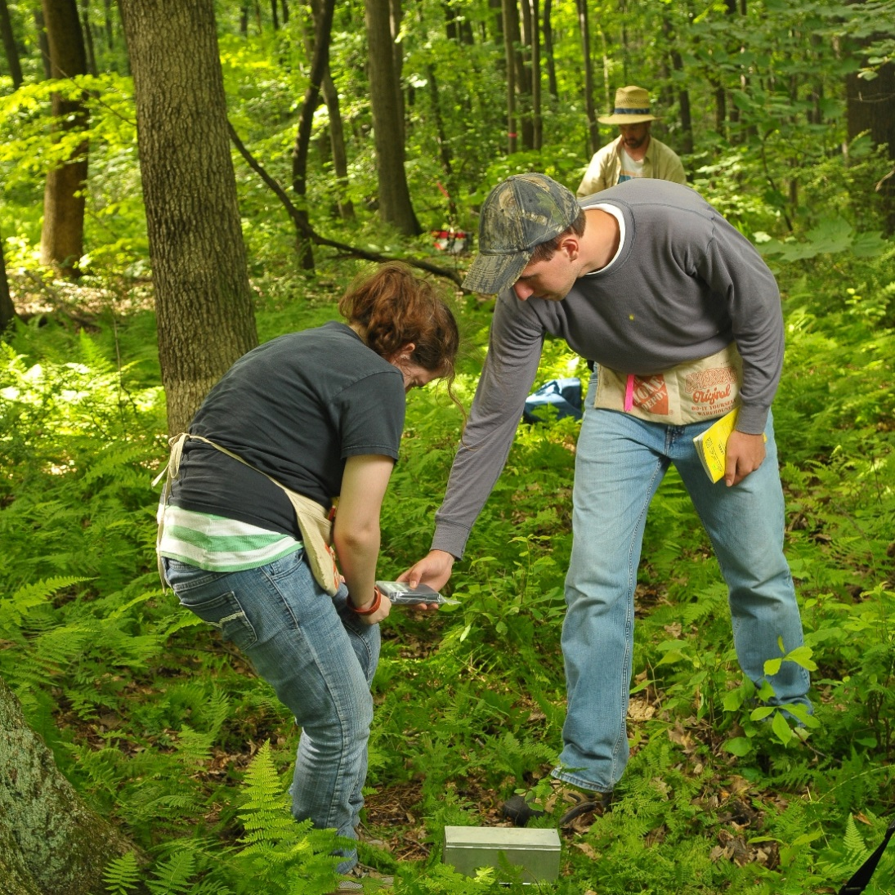
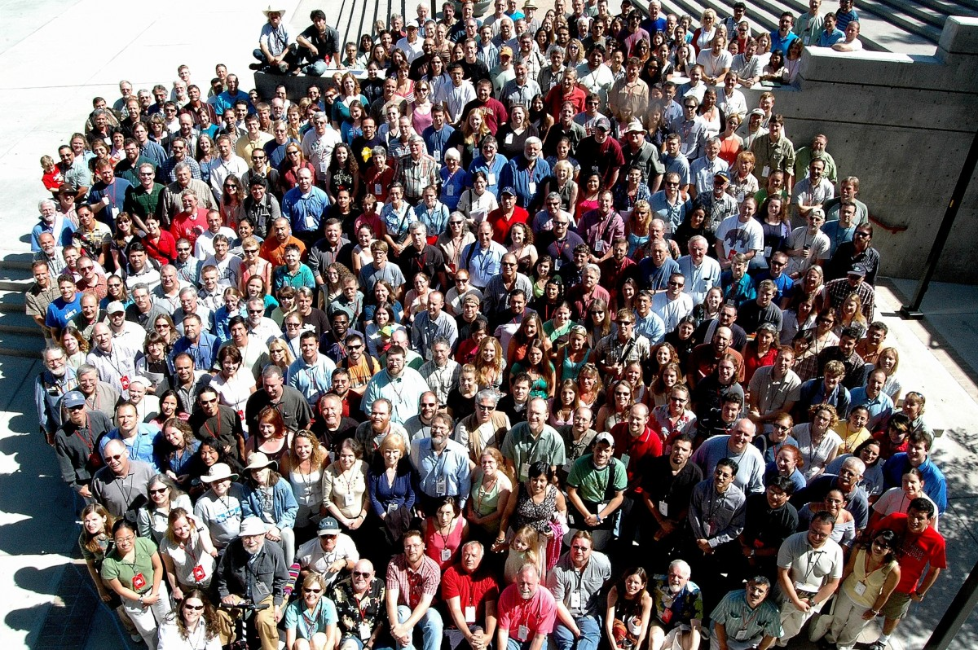




52
71
99
90
American Society of Mammalogists
Membership Benefits
Stay Up To Date
    Digital Access to Journal of Mammalogy
    and Mammalian Species
    Page Charge Waivers for JM
    ASM Newsletters
    ASM Website, with Members’ Services
    Page and Mammal Images Library
    ASM Facebook, Google+, LinkedIn,
    & Twitter Accounts
    World Mammal Societies Facebook Accounts
Student Benefits
    Reduced Membership Rates
    Grants-In-Aid of Research
    Student Honoraria, Fellowships,
    and Travel Awards
    Student Social/Mixer at Annual Meeting
    Presentation Evaluation
    Professional Development &
    Career Enhancement Workshops
    Meal with a Mammalogist Program
ASM Annual Meeting
    Discount on Registration
    Showcase of Cutting Edge Research
    Networking & Professional
    Development Opportunities
    Participation in Policy Development
    Expert-led Workshops & Symposia
    Socials, Field Trips, Live Auction,
    & Gordon L. Kirkland Run for
    Research
Support Your Profession
    Taxon-specific Guidelines for Care and
    Use of Wild Mammals in Research
    Review & Updates of Mammalian
    Taxonomy (Mammal Species of the World)
    Review & Accreditation of Scientific
    Collections
    Position Papers, Resolutions, & Letters
    on Important Mammalogical Issues
International Mammalogist Benefits
    Reduced Membership Rates for
    Developing Countries
    Latin American Student Research Grants
    African Student Research Grants
    Oliver P. Pearson Professional
    Mammalogist Award
    “Buddy System” Review Service
Participate in Society Activities
    Run for ASM Office
    Vote in Elections
    Serve on Standing Committees
    Nominate Award Candidates
    Vote for Annual Meeting Site
    Membership Directory
    (~2500 members)
Mam·mal·o·gy / a branch of zoology dealing with mammals
Mam·mal·o·gist / a person with the best job in the world!
www.mammalsociety.org/
@MAMMALOGISTS
87th Annual ASM Meeting Group Photo
Albuquerque, New Mexico, June 2007

